Slide 1
Servlets

Slide 2
How the internet works
Internet uses Client/Server technology for its working
The world wide web uses the Browser as the client software and Web Server as the server software
The user types the required URL in the browser
Notes:
Even though we can use any application as the client program in an internet application, typically browser is used as the client program. This will make the client side deployment very easy. For example, if a Java application is used as the client program, this application needs to be installed in all the client machines. If browser is used as the client, the user can install any browser of her choice in the client machine and access the internet application

Slide 3
How the internet works
The IP Address of the Server is found from the URL
The Web Server will be listening in that Server at Port No 80
The browser connects to Port No 80 of the specified Server
Based on the request, the Web Server will deliver the appropriate page to the browser
Notes:
The standard port number used by HTTP is 80. The browser assumes the web server to be listening at port number 80. Any how, we can configure web servers to listen to other port numbers also. For example, if we want to run a web server in a machine where already a web server is running, we have to configure the second web server to listen to another port. Port number 8080 is popularly used in such cases

Slide 4
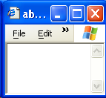

How the internet works
2, Web Server
1. User Request
retrieving
requested static
The
web page
Internet
Server’s
File
3. Reply
System
Web
Server

Slide 5
HTTP Protocol
This kind of Client/Server communication should follow a Protocol for its smooth functioning
Hyper Text Transfer Protocol or HTTP is the protocol used by the Web
According to the HTTP protocol, the client should send a Request to the server in a special format
Based on the Request, the server will send back a Response, which again is in a special format

Slide 6
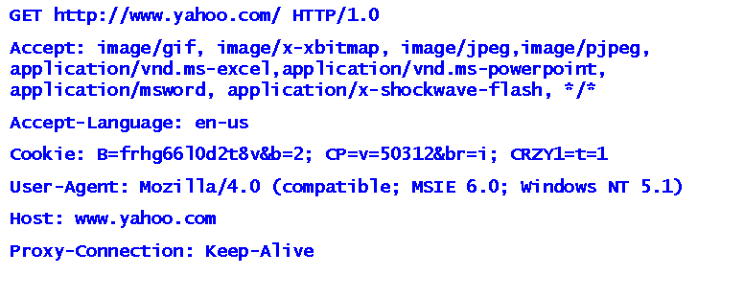
HTTP Request
The following is the request generated by Internet Explorer when the URL was http://www.yahoo.com
Notes:
The user types only the URL on the browser. But according to HTTP protocol, the request should contain some more information in a special format. Since the browser follows the HTTP protocol, it will automatically create the HTTP Request in the specified format using the URL typed by the user and adding the extra information as shown in this slide

Slide 7
HTTP Request
The first thing specified by a Request is a HTTP command called METHOD
This tells the Server the kind of service you require
The two important methods are GET and POST
This will be followed by the path of the document the browser requires and the version of HTTP used by the client

Slide 8
HTTP Request
After this, the client can send optional header information to tell extra things to the server
The software used by the client, the content types the client would understand etc., are communicated to the server with the help of these headers
The headers will help the server to give the response properly
After the header information, the client should send a blank line to indicate that the header information is over

Slide 9
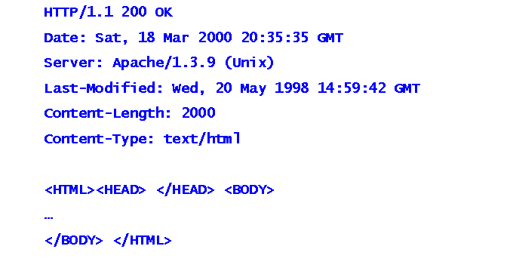
HTTP Response
The server processes the request and sends a Response
The following is an example of a response

Slide 10
HTTP Response
The first line of the Response is called the status line
The status line should contain the HTTP version, Status Code and a Status Description
The following are some examples of status code used by HTTP
  200 - Ok
  400 – Bad Request
  401 – Unauthorized
  403 – Forbidden
  404 – Not Found
  500 – Internal Server Error

Slide 11
HTTP Response
After the status line comes the Response headers
The software used by the server, content type of the response etc. will be communicated to the browser using these headers
There should be a blank line to show that the header information is over
After the headers, the server sends the data on success or an error description on failure

Slide 12
Dynamic Pages
From the web, we get static pages as well as dynamic pages
Static page is a page that does not change with user and/or time
Dynamic page is a page that changes with user and/or time
For delivering a static page, all we require at the server side is the Web Server and the HTML file
Notes:
A web page that displays the current time is a dynamic page as it changes with the time. So we require a program that will generate a page that contains the current time
The “Inbox” page of the mail applications like hotmail and yahoo will depend on the user. So, this page is also dynamic and requires a program to generate it based on the user

Slide 13
Dynamic Pages
But a dynamic page cannot be created in advance and kept as an HTML file
So, to have a dynamic page, apart from the Web Server, we require a program to generate the dynamic content
In some cases, the Web Server itself will be able to execute this program
In some other cases, we may require an extra software component that can execute this program

Slide 14
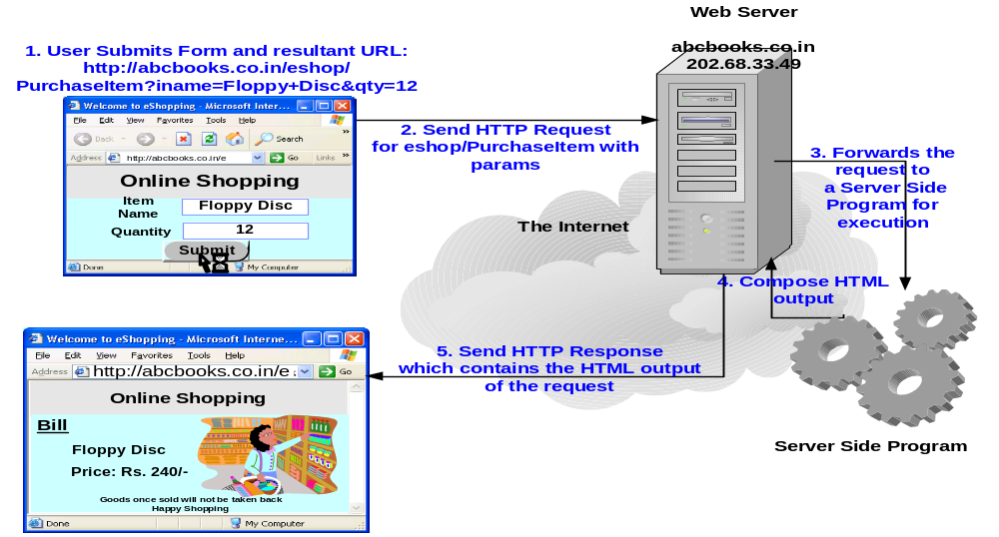
Dynamic Pages

Slide 15
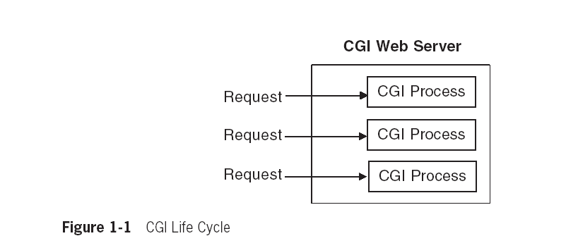
CGI Technology
CGI technology was first used to generate dynamic content
In CGI, the server should start a new process to run a CGI program for each client request
This requires significant time and resources
So, CGI programs were not scalable

Slide 16
Servlet Concepts
Server side programs written in Java.
A servlet is a Java programming language class that is used to extend the capabilities of servers that host applications access via a request-response programming model. Although servlets can respond to any type of request, they are commonly used to extend the applications hosted by web servers. For such applications, Java Servlet technology defines HTTP-specific servlet classes
Deployed in a Web container of an application server which provides a runtime environment for servlets.
Executed when the J2EE application server receives a client request that is passed to the Web container, which in turn invokes the servlet.

Slide 17
Advantages over CGI
With traditional CGI, a new process is started for each HTTP request. If the CGI program itself is relatively short, the overhead of starting the process can dominate the execution time. With servlets, the Java virtual machine stays running and handles each request with a lightweight Java thread, not a heavyweight operating system process
in traditional CGI, if there are N requests to the same CGI program, the code for the CGI program is loaded into memory N times. With servlets, however, there would be N threads, but only a single copy of the servlet class would be loaded
Servlets have an extensive infrastructure for automatically parsing and decoding HTML form data, reading and setting HTTP headers, handling cookies, tracking sessions, and many other such high-level utilities.

Slide 18
Servlet Concepts
For executing the Servlets, the Web Server requires the help of another piece of software called the Servlet Container
The terms Application Server, Servlet Engine and Servlet Runner are also used instead of Container
The Servlet Container may be built into the Web Server or can be implemented as a separate module
Tomcat is a Servlet Container that is popularly used

Slide 19
Servlets
The Container should be able to execute any Servlet
This requirement calls for a standard interface for all the Servlets
A class should implement the interface called Servlet in the package javax.servlet to become a Servlet

Slide 20
Servlets
The important methods of the Servlet interface are as follows
  void init(ServletConfig)
  void service(ServletRequest, ServletResponse)
  void destroy()
The Servlet Container will do the following
  Create and initialize the Servlet by calling the init method
  Handle requests from clients by calling the service method
  Destroy the Servlet by calling the destroy method and garbage collect it

Slide 21
Servlet API

Slide 22
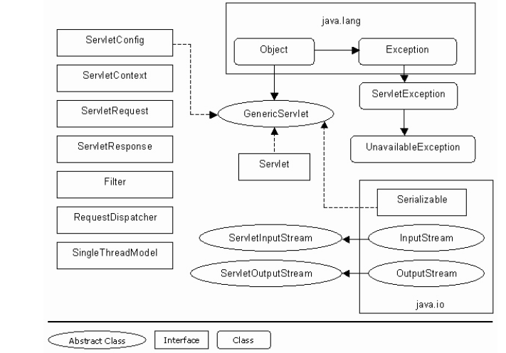
Servlet API
Notes:
The root of servlet class / interface hierarchy is Servlet interface
GenericServlet makes writing servlet easier, it provides simple implementation of the lifecycle methods
HttpServlet is HTTP protocol specific , hence any user-defined servlet need to receive and respond to request on the HTTP protocol, need to subclass HttpServlet Class
ServletConfig interface is implemented by servlet container in order to pass configuration info

Slide 23
The GenericServlet
For implementing the Servlet interface, the programmer has to implement all the methods of the Servlet interface
Most often, the programmer will be interested in the service method only
The class GenericServlet of javax.servlet package implements the Servlet interface

Slide 24
The GenericServlet
GenericServlet implements the init and destroy methods
The service method is left as an abstract method for the Servlet programmer to implement
So, for creating a Servlet, it is easy to extend the GenericServlet class than to implement the Servlet interface

Slide 25
First Example

Slide 26
Hello World Example
import javax.servlet.*;
import java.io.*;
public class HelloWorldServlet extends GenericServlet
{
public void service(ServletRequest req, ServletResponse res) throws ServletException, IOException
{
res.setContentType("text/html");
PrintWriter out = res.getWriter();
out.println("hello world servlet!!!!!");
}
}

Slide 27
Deployment Descriptor file
Web.xml is a deployment descriptor file that describes the deployment settings of an application, a module, or a component
Servlet mapping in web.xml
<servlet>
<servlet-name>HelloWorldServlet</servlet-name>
<servlet-class>HelloWorldServlet</servlet-class>
</servlet>
<servlet-mapping>
<servlet-name>HelloWorldServlet</servlet-name>
<url-pattern>/HelloWorldServlet</url-pattern>
</servlet-mapping>

Slide 28
Set the path and class path
Compile .java file to obtain .class file
Package .class and web.xml file in .war file
Deploy .war file into a Web container of a Web-server
Open the browser and type :
http://localhost:8080/war_name/HelloWorldServlet

Slide 29
Servlet Life cycle
The life cycle of a servlet is controlled by the container in which the servlet has been deployed. When a request is mapped to a servlet, the container performs the following steps.
If an instance of the servlet does not exist, the Web container
  Loads the servlet class.
  Creates an instance of the servlet class.
  Initializes the servlet instance by calling the init() method
  Invokes the service() method, passing a request and response object.
  If the container needs to remove the servlet, it finalizes the servlet by calling the servlet's destroy() method.

Slide 30
The Servlet Lifecycle
A new Servlet object is not instantiated for each subsequent request
The Servlet Container will spawn a thread for each request to call the service method of the same Servlet object
This makes the Servlet technology faster and scalable

Slide 31
More about service
Most of the containers will create only one instance of a Servlet
The same instance is used for servicing all the clients
For each client request, the container may execute the service method in a thread
So for multiple client requests, only multiple threads are created and not multiple objects
This model requires lesser memory and lesser time compared to the multiple object model
This model also enables persistence, for example, a database connection can be opened once and used by many requests

Slide 32
Thread Safe Servlets
Many threads running the service method at the same time can create problems in some cases

Slide 33
Synchronized
A Servlet can be made thread safe in several ways
A Servlet can be made thread safe by making the doGet or doPost method synchronized
Since only one client can use the doGet or doPost method at a time this may lead to performance issues
Instead of making the whole doGet or doPost method synchronized, we can use synchronized blocks to make just some critical statements synchronized
synchronized(this)
{ ++count;
out.print("Count is " + count);
}

Slide 34
Synchronized
The performance can be improved by minimizing the number of statements appearing inside the synchronized block
int localCount;
synchronized(this)
{
localCount = ++count;
}
out.print("Count is " + localCount);

Slide 35
Local Variables
The problems with multiple threads accessing the service of the Servlet is applicable to the class variables as only one instance of the Servlet is created for all requests
Any how, the local variables are not affected by this problem as each thread will have a separate copy of these
Do a thorough code review to ensure that we are not unnecessarily using a class variable in a situation that can be managed by a local variable

Slide 36
init() method
You can override the class initializer init() if you need to initialize or allocate resources for the life of the Servlet instance, such as a counter. The init() method runs after the servlet is instantiated but before it accepts any requests.
Reading persistent configuration data
Initializing instance variables
Perform one-time application specific activities.
Encapsulates the initialization information through ServletConfig instance.

Slide 37
More about init
The Servlet container will pass the ServletConfig object as a parameter to the init() method
Even though it is the init() method that gets the ServletConfig object
The init() method should save this object in a class variable, so that all methods of the Servlet can access it

Slide 38
More about init
public class CommonCodeServlet extends GenericServlet
{
private ServletConfig config;
public void init(ServletConfig config) throws ServletException
{
      //Stores the config object in a class variable
      //so that service method can also use it
      this.config = config;
}
public void service(ServletRequest request,ServletResponse response)
throws ServletException, IOException
{
//Use config object
}
}

Slide 39
More about init
The code shown in the previous slide is the most common code we write in the init method
The init method of the class GenericServlet contains similar statements and hence classes that are inherited from GenericServlet need not override this method just for storing the ServletConfig object in a class variable

Slide 40
More about init
class GenericServlet implements Servlet
{ private transient ServletConfig config
  public void init(ServletConfig servletconfig) throws ServletException
  { config = servletconfig;
    //More statements
  }
  public ServletConfig getServletConfig()
  { return config;
  }
  //Other methods
}
Now, other methods can also access the ServletConfig object using the getServletConfig method

Slide 41
More about init
A Servlet that extends GenericServlet may want to store the ServletConfig object in a class variable and do some more work
In such cases, GenericServlet helps the programmer to do more during initialization as follows
public void init(ServletConfig servletconfig) throws ServletException
{
  config = servletconfig;
  //More statements
  init();
}
public void init() throws ServletException
{
}

Slide 42
More about init
The init(ServletConfig) method of GenericServlet calls another method called init() and a blank implementation of init() is provided in GenericServlet
The programmer can override the init() method to do more in the init(ServletConfig) method
The programmers who are extending GenericServlet need not bother about init(ServletConfig) and instead, they can override init()

Slide 43
More about init
The programmer can call a method on the ServletConfig object in two different ways
One way is to get a reference to the ServletConfig object by calling the getServletConfig method and call the method using this reference
The second method is easier
The GenericServlet class is implementing the ServletConfig object
All the methods in ServletConfig object are available in GenericServlet itself

Slide 44
More about init
Instead of calling the methods on the ServletConfig object, we can just call it on the GenericServlet
The GenericServlet will in turn call the corresponding method of the ServletConfig object and give the result
For example, the GenericServlet class implements the public String getInitParameter(String parametername) of ServletConfig as follows
public String getInitParameter(String name)
{
return getServletConfig().getInitParameter(name);
}

Slide 45
destroy() method
When a server unloads a servlet, it calls the servlet's destroy method. The destroy method should undo any initialization work and synchronize persistent state with the current in-memory state.
For many servlets, however, there is initialization work that must be undone. For example, assume there is a servlet that opens a database connection during initialization. Its destroy method, shown as an example below, would close that connection
public void destroy()
{
try
{
con.close();
}
catch (SQLException e){ }
}

Slide 46
GET and POST
The two most common HTTP methods are GET and POST
Very often we supply some data to a web application to get more data
For example, we supply the Item Code of a product to a web application to collect all the details of the product
GET method is used in such situations

Slide 47
GET and POST
Some times, we post a lot of data to a web application
For example, we supply our name, address, hobbies and other details to ourselves registered with a group
POST method is used in such situations

Slide 48
GET and POST
When we use the GET method for sending some data to the Server, the data will be send as a Query String attached at the end of the URL after a “?”
http://localhost:8080/myapp/HelloUserServlet?UserName=CTS
So, if there is a password field, GET method will make it visible on the address bar of the browser!
POST method will send the data as a part of the request, after the header information
So, the passing of data is not visible to the user

Slide 49
GET and POST
Since GET method is meant for passing some data to get more data, some servers limit the quantity of data you can pass using the GET method whereas, POST method can send large quantity of data
URLs with POST method cannot be book marked where as GET method can be
GET method is faster than POST method

Slide 50
The HttpServlet
The class GenericServlet is not designed for any particular protocol
But mostly Servlets are used for creating Web Applications that follow HTTP protocol
While following HTTP protocol, the programmer may want to do different things based on the HTTP method used by the client – GET or POST
In such cases, using the class javax.http.HttpServlet will be easier then using GenericServlet
Notes:
HTTP has many methods – GET, POST, HEAD, DELETE etc. HttpServlet has methods corresponding to all these methods – doGet, doPost, doHead, doDelete etc. The doGet and doPost methods are the most commonly used methods as GET and POST are the commonly used HTTP methods

Slide 51
The HttpServlet
The HttpServlet class is inherited from GenericServlet and contains two important methods, doGet and doPost
HttpServlet overrides the service method and calls the methods doGet or doPost based on the HTTP method used by the client
The Servlets that create Web Applications will be extending HttpServlet and overriding the doGet and/or doPost methods instead of the service method
Notes:
Servlet architecture is not protocol specific. A Servlet can be created for processing any protocol. Even GenericServlet is not designed for any specific protocol. HttpServlet extends GenericServlet adding support for the HTTP protocol.

Slide 52
More examples
In case the HttpServlet wants to execute the same statements for both GET and POST method, the user can implement either doGet or doPost and the other method can simply call the implemented method

Slide 53
Request parameter demo
<HTML>
<BODY>
<FORM METHOD="GET" ACTION="http://localhost:8080/requestparam_war/requestparam">
<H2 ALIGN=CENTER>Request parameter demo<CENTER></H2>
Enter Employee name :
<INPUT TYPE=TEXT NAME="t1" >
<INPUT TYPE= SUBMIT VALUE=Submit>
</FORM>
</BODY>
</HTML>

Slide 54
Import javax.servlet.*;
Import javax.servlet.http.*;
Import java.io.*;
public class requestparam extends HttpServlet
{
String name;
public void doGet( HttpServletRequest req, HttpServletResponse res) throws ServletException, IOException
{
res.setContentType("text/html");
PrintWriter out = res.getWriter();
name= req.getParameter(“t1”);
out.println(“welcome : “ +name);
}
}

Slide 55
Handling HTTP Methods
  At times, while working with servlet applications, you are not sure of whether the client is making a GET request or a POST request.
  In such a situation, the server returns a response that the particular method is not supported by the servlet.
  To avoid such instances:
    Provide request handling code inside doPost() method.
    Call the doPost() method from within the doGet() method.
  This will ensure that the client request is always serviced no matter which method is invoked.

Slide 56
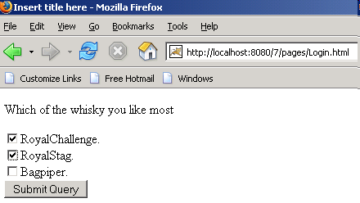
Multiple values for a single parameter
<input type = "checkbox" name ="whisky" value = "RoyalChallenge">RoyalChallenge.<input type = "checkbox" name ="whisky" value = "RoyalStag">RoyalStag.
<input type = "checkbox" name ="whisky" value = "Bagpiper">Bagpiper.
String[] whisky = request.getParameterValues("whisky");
for(int i=0; i<whisky.length; i++){
pw.println("<br>whisky : " + whisky[i]);
}

Slide 57
Request Headers
Request Headers: when an http client (browser) sends a request then it also sends a number of headers.programme to display all header and it’s value
public class ShowRequestHeaders extends HttpServlet {
public void doGet(HttpServletRequest request,
HttpServletResponse response)
throws ServletException, IOException {
response.setContentType("text/html");
PrintWriter out = response.getWriter();
String title = "Servlet Example: Showing Request Headers";
out.println("Request Method:" +request.getMethod());
out.println("Request URI:" +request.getRequestURI());
out.println("Request Protocol::" +request.getProtocol());
Enumeration headerNames = request.getHeaderNames();
while(headerNames.hasMoreElements())
{
String headerName = (String)headerNames.nextElement();
out.println(headerName + ":" +request.getHeader(headerName) );
} } }

Slide 58
Error Handling
When a Servlet comes across an Error or Exception, the following things are to be done
  Make sure that it causes minimum harm to the server
  Report to the client
  Log it in a log file for the server administrator
Reporting to the client can be done using the sendError method of HttpServletResponse
The error can also be logged in a log file using the log method of GenericServlet
The name of the log file can be specified in server.xml

Slide 59
Configuring Error Pages
We can configure the web application using web.xml to customize an error page
Now, 404.html will be displayed whenever the status code is 404
<error-page>
<error-code>404</error-code>
<location>/404.html</location>
</error-page>

Slide 60
Exception Handling
Any exception that is thrown by the Servlet and not handled by itself will be handled by its container
The container handles the exception in a container specific way
Servlets that are designed to work on multiple containers cannot depend on this
Such Servlets require their own exception handling techniques

Slide 61
ServletException
If we want the container to handle other exceptions as well, the Servlet may catch the actual exception and throw ServletException in turn
Now, the container can catch this exception and handle it
try {
  //Some statements
}
catch(IOException exception){
  throw new ServletException();
}

Slide 62
UnavailableException
A Servlet may be unavailable permanently or temporarily
Servlets that cannot recover from an error are permanently unavailable
Servlets that cannot handle the requests for some time, for example due to insufficient disk space, can continue giving service once the administrator has cleared some disk space
Such Servlets are temporarily unavailable
The class UnavailableException which is a sub class of ServletException will help the programmer to communicate these to the container

Slide 63
Configuring Exception Pages
Just like error pages, we can configure Exception pages also to generate customized messages
Now, ExceptionPage.html will be displayed, whenever ServletException is thrown by the Servlet
<error-page>
<exception-type>javax.servlet.ServletException
</exception-type>
<location>/ExceptionPage.html</location>
</error-page>

Slide 64
ServletContext Interface
Give Servlet access to information about their enviroment
Allow them to log significant event
getServerInfo() : returns the name and version of container
Get/setAttribute() : return/set the servlet Container attributes
Log(String) : Writes a specified String to servlet log file

Slide 65
Example
public class ContextAdder extends HttpServlet
{
ServletContext ctx;
public void init(ServletConfig cfig)
{
ctx = cfig.getServletContext();
}
public void doGet (HttpServletRequest request, HttpServletResponse response) throws ServletException, IOException
{
/*Set portno attribute with value 8080 in servlet context*/
ctx.setAttribute("portno","8080");
/*Redirect to ContextRetriever servlet*/
response.sendRedirect("http://localhost:8080/servlet/ContextRetriever");
}
}

Slide 66
public class ContextRetriever extends HttpServlet
{
ServletContext ctx = null;
public void init(ServletConfig cfig)
{
ctx = cfig.getServletContext();
}
public void doGet (HttpServletRequest request, HttpServletResponse response) throws ServletException, IOException
{
/*Retrieve value of portNo attribute from servlet context*/
String contextValue= (String)ctx.getAttribute("portno");
response.setContentType("text/html");
PrintWriter pw = response.getWriter();
pw.println("<B>The retrieved context value is: "+ contextValue + "<BR></B>");
} }

Slide 67
Inter-Servlet communication
A process where two or more servlets communicates with each other to process the client request.
A servlet can forward the request to another servlet to process the client request.
A servlet can include the output of another servlet to process the client request.

Slide 68
RequestDispatcher interface
Is an object of the javax.servlet.RequestDispatcher interface that allows inter-servlet communication.
Object is used to include the content of another servlet.
Object is used to forward the request to another servlet
Stores the calculated data as attribute to the request object in the first servlet.
Forwards the request to the second servlet using the RequestDispatcher.
Retrieves the data from the request object and displays the result using the second servlet.

Slide 69
package javax.servlet;
public interface RequestDispatcher
{
public void forward(ServletRequest request, ServletResponse response) throws ServletException, java.io.IOException;
public void include(ServletRequest request, ServletResponse response) throws ServletException, java.io.IOException;
}
forward() : This method forward a request to another resources on the same Server (Servlet ,JSP ,html)
include() : This method include the response from given (Servlet,JSP,Html ) within the caller response

Slide 70
An object implementing the RequestDispatcher interface may be obtained via the following methods:
ServletContext.getRequestDispatcher(String path)
ServletRequest.getRequestDispatcher(String path)
The ServletContext.getRequestDispatcher method takes a String argument describing a path within the scope of the ServletContext. This path must be relative to the root of the ServletContext and begin with a '/'.
To allow RequestDispatcher objects to be obtained using relative paths that are relative to the path of the current request (not relative to the root of the ServletContext), the ServletRequest.getRequestDispatcher method is provided in the ServletRequest interface
a request dispatcher obtained via ServletRequest.getRequestDispatcher("header.html") will behave exactly like a call to ServletContext.getRequestDispatcher("/garden/header.html").

Slide 71
public class ForwardError extends HttpServlet
{
public void doGet(HttpServletRequest request, HttpServletResponse response) throws ServletException, IOException
{
/* Retrieve the ServletConfig and ServletContext objects. */
ServletConfig config=getServletConfig();
ServletContext contx=config.getServletContext();
/* Retrieve the RequestDispatcher object */
RequestDispatcher dispatcher=contx.getRequestDispatcher("/servlet/ErrorServlet");
try {
/* Throw NumberFormatException. */
int x=Integer.parseInt("samplestring");
} catch (Exception ex)
{
request.setAttribute("EXCEPTION", ex);
/* Dispatch the request to ErrorServlet servlet. */
dispatcher.forward(request, response);
} } }

Slide 72
public class ErrorServlet extends HttpServlet
{
public void doGet(HttpServletRequest request, HttpServletResponse response) throws ServletException, IOException
{
PrintWriter pw= response.getWriter();
Exception exc = (Exception)request.getAttribute("EXCEPTION");
String msg = exc.getMessage();
pw.println("<HTML>");
pw.println("<BODY>");
pw.println("<H1>OOP'S An error has occurred. </H1>");
/* Display the exception class and message. */
pw.println("<B> Exception Type : " + exc.getClass() + " <BR/>");
pw.println("<B> Message : " + msg + " <BR/><HR/>");
pw.println("Please try again......................");
pw.println("</BODY>");
pw.println("</HTML>");
} }

Slide 73
Session Management
  The interaction between a Web browser and a Web server is stateless. The browser connects to the server, requests a single piece of information, then disconnects, at this point the server completely forgets about the transaction and awaits the next request.
  Session management refers to tracking the state of an end user across Web pages.
  Session management enables programmers to create applications where the state of an end user is required to be maintained across multiple Web pages.

Slide 74
  The techniques for managing the state of an end user are:
    Hidden form field
    URL rewriting
    Cookies
    Servlet session API

Slide 75
Hidden Form Field
Simplest technique to maintain the state of an end user.
Embedded in an HTML form.
Not visible when you view an HTML file in a browser window.
Not able to maintain the state of an end user when it
encounters a static document

Slide 76
URL Rewriting
Maintains the state of end user by modifying the URL.
Is used when the information to be transferred is not critical.
Cannot be used for maintaining the state of an end user when a static document is encountered.

Slide 77
Cookies
Cookies are small bits of textual information that a Web server sends to a browser and that the browser later returns unchanged when visiting the same Web site or domain.
Are chunks of information created by the server and are stored by the browser on the client machine
Supported by the Web browser and the size of each cookie is maximum of 4 bytes.
Benefits of Cookies
Identifying a User During a Session
Avoiding Username and Password
Customizing a Site and advertisement

Slide 78
The following table describes the methods defined in the Cookie class:
Method
Description
public String getName()
Returns the name of the cookie.
public void setMaxAge(int expiry)
Sets the maximum time for which the client browser retains the cookie
public int getMaxAge()
Returns the maximum age of the cookie in seconds.
public void setValue(String (value)
Sets a new value to the cookie.
public String getValue()
Returns the value of the cookie.

Slide 79
public class CookieClass extends HttpServlet
{
int Counter=0;
Cookie c;
public void doGet (HttpServletRequest Hsr, HttpServletResponse Hss)
throws ServletException, IOException
{
PrintWriter pw = Hss.getWriter ();
Hss.setContentType ("text/html");
Cookie cks[] = Hsr.getCookies ();
if ( cks == null )
{
Counter++;
c = new Cookie ("mycookie", + Counter);
c.setMaxAge(6000);
Hss.addCookie(c);
pw.println ("No Cookies for this client. One will be generated.");
} else
pw.println ("Already has a Cookie. name :" +c.getName()+ " value is" +c.getValue());
pw.println ("Servlet Responded Again.\n");
}
}

Slide 80
public class ShowSession extends HttpServlet {
public void doGet(HttpServletRequest request, HttpServletResponse response)
throws ServletException, IOException {
response.setContentType("text/html");
PrintWriter out = response.getWriter();
HttpSession session = request.getSession(true);
String heading;
Integer accessCount =(Integer)session.getAttribute("accessCount");
if (accessCount == null) {
accessCount = new Integer(0);
heading = "Welcome, Newcomer";
} else {
heading = "Welcome Back";
accessCount = new Integer(accessCount.intValue() + 1);
}
session.setAttribute("accessCount", accessCount);
out.print("<BR> session id: " +session.getId());
out.print("<BR> session creation time: " +new Date(session.getCreationTime()));
out.print("<BR> LastAccess Time: " +new Date(session.getLastAccessedTime()));
out.print("<BR> total time access: " +accessCount );
} }

Slide 81
Cookies
A cookie is some information the web server sends to the browser
The browser will accept this information and stores it
This information can be read back later by the web server
The class Cookie in the package javax.servlet.http will help to create a cookie
The class Cookie has a constructor that takes two String objects as parameters – name and value
Cookie c = new Cookie(“UserName”, “IBM”);

Slide 82
Cookies
The method addCookie(Cookie) of HttpServletResponse can be used to add a Cookie
The method getCookies() of HttpServletRequest will return an array of Cookies that were stored earlier by this domain
The methods getName() and getValue() of the Cookie class can be used to get the name and value of the Cookie
The method setMaxAge(int) can be used to specify the maximum age of a Cookie in seconds
Notes:
Cookies can be used by a server to track the pages you have visited or by an advertiser to track the products you have bought. If you do not want this to happen, the browser will permit you to block Cookies
Start Internet Explorer, select the menu Tools, Internet Options in the browser and click on the tab Privacy. Click on the button Advanced and check the Override automatic cookie handling checkbox. Now you will have three options for the Cookies - Accept, Block and Prompt, using which you can accept all Cookies or block all Cookies or ask the browser to prompt you before accepting a Cookie. You can set these options for first-party Cookies and third-party cookies. First-party Cookie is a Cookie from the web site that the client is currently viewing. Some content of this site, for example advertisements, may be provided by another site. The Cookies from those sites are third-party Cookies

